Slide 1
"What Were They Thinking?":
Why We Make Stupid Mistakes,
And Ways To Minimize Them

Slide 2
Causes of mistakes, errors, incidents…
Human error
Lack of focus on the task at hand
Inattention to detail
…Sound familiar?

Slide 3
What causes people who are fully competent, motivated, and well-intentioned to make the simplest of mistakes?
**** “What were they thinking?!?!” ****
Well obviously, they weren’t….or were they?

Slide 4
Three common terms:
Attention
Focus
Concentration

Slide 5
Attention - notice taken or perception of a situation or fact
Focus - the center of interest or activity
Concentration – maintaining one’s attention or focus for a period of time

Slide 6
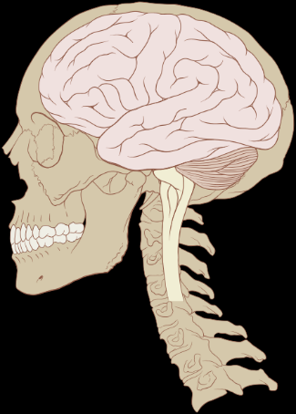
Our Brain….An Incredible Device
Highly Efficient
Hard working
Adaptable and Resilient
Able to be attentive, focused, and concentrate
3 lbs in a 5”x5”x7” space

Slide 7
So why do we make mistakes given our exceptional brains?
The same positive qualities often work against us.

Slide 8
Quality #1: Focus and Selective Attention
Our ability to focus is key to performing work accurately, safely, and efficiently. Tuning out unnecessary or non-critical information around us gives us the ability to focus, and doing so over time gives us the ability to concentrate and perform tasks correctly.

Slide 9
Watch this video and answer the question
https://www.youtube.com/watch?v=vJG698U2Mvo

Slide 10
Quality #1: Focus and Selective Attention
Who counted correctly?
Who saw the gorilla?
Try again, and see if you can count and spot the gorilla.

Slide 11
Can you count passes and spot the gorilla?
https://www.youtube.com/watch?v=IGQmdoK_ZfY

Slide 12
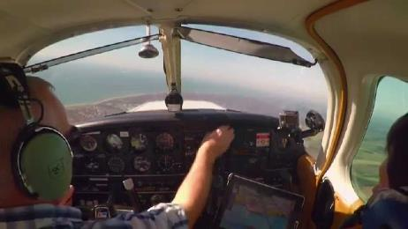
Quality #1: Focus and Selective Attention
Situational awareness
Eastern Airlines, Florida, 1972
Landing Gear Indication Light
Autopilot unknowingly disconnected
101 fatalities of 176 onboard
United Airlines, Oregon, 1978
Landing Gear issue
Engine Flameout on Low Fuel
10 fatalities of 189 onboard
Aviation accidents brought this to light

Slide 13
Quality #1: Focus and Selective Attention
Situational awareness
Factors that reduce situational awareness
Workload
Pattern matching
Degraded operating conditions
Crew issues
Communication

Slide 14
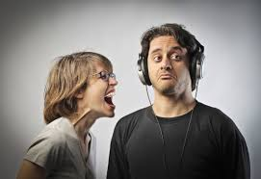
Quality #1: Focus and Selective Attention
filtering
Necessary to allow brain to process most important
most people do it all the time, both intentionally and unintentionally
Research indicates some mental illnesses are rooted in the brain’s inability to filter non-essential inputs, thus overloading the victim’s capability to process the most important information

Slide 15
Count the number of times you find the letter “F” in the following sentence:
These functional fuses have been developed after years of scientific investigation of electric phenomena, combined with the fruits of long experience on the part of the two investigators who have come forward with them for our meeting today.
These functional fuses have been developed after years of scientific investigation of electric phenomena, combined with the fruits of long experience on the part of the two investigators who have come forward with them for our meeting today.
These functional fuses have been developed after years of scientific investigation of electric phenomena, combined with the fruits of long experience on the part of the two investigators who have come forward with them for our meeting today.
These functional fuses have been developed after years of scientific investigation of electric phenomena, combined with the fruits of long experience on the part of the two investigators who have come forward with them for our meeting today.
5?
7?
11?

Slide 16
Count the number of times you find the letter “N” in the following sentence:
Count first by reading, count again by going backwards
The natural beauty of the springtime is uplifting to the soul after the long season of winter, when a person sees life in abundance emanating from an extended rest in the soil, upon the waters, and up in the trees.
The natural beauty of the springtime is uplifting to the soul after the long season of winter, when a person sees life in abundance emanating from an extended rest in the soil, upon the waters, and up in the trees.
19

Slide 17
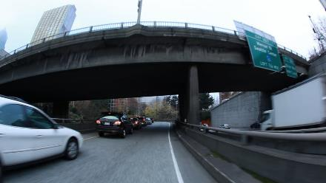
Quality #1: Focus and Selective Attention
filtering
How much do you recall from your drive to work yesterday?
Occurs during the performance of routine tasks in familiar surroundings
Automatic processing needs to be periodically stopped to allow conscious component of the brain to check on progress

Slide 18
Quality #1: Focus and Selective Attention
How is this a good quality? a bad quality?
What might you do to take advantage of this quality?
What Might you do to avoid the downside of this quality?

Slide 19
Quality #2: Multi-tasking
We may think we have an ability to focus on several tasks “simultaneously”, but what really happens is our brain is focusing on one task at a time, but quickly switching between the two.
The issue on multi-tasking is how effectively our brain can leave one task and fully focus on the next task. To fully disconnect and reconnect takes time, more time than we often appreciate or provide. This results in the concurrent tasks being performed poorly or incorrectly at some point.

Slide 20
Shout out the shapes of the diagrams you see
circle
triangle
square

Slide 21
Shout out the color of the word
blue orange green red purple
green purple blue orange red
red green orange purple blue

Slide 22
Where is the word located relative to the rectangle?
left

Slide 23
Where is the word located relative to the rectangle?
Below

Slide 24
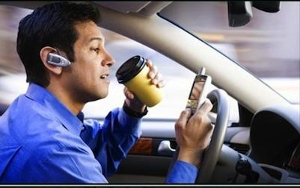
Quality #2: Multi-tasking
Distracted driving
National Highway Traffic Safety Administration detailed study with dashcams found:
Drivers were looking away or engaging in a secondary task in
78% of all crashes
65% of all near crashes
Prior research based on what drivers said they did indicated only 25% of crashes were due to inattention or distraction

Slide 25
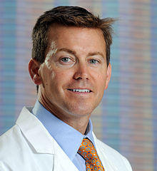
Quality #2: Multi-tasking
Checklists for
Critical Tasks
Dr Peter Provnost identified 5-step checklist to combat central line infections
ICU doctors insert 4 million lines each year; 4% become infected with 5-25% of those patients dying and those who survive spend ~ 10 additional days in hospital
Michigan hospitals implemented the checklist
Infections fell 66% in 3 months
Saved ~ 1,500 lives and $175 million

Slide 26
Quality #2: Multi-Tasking
How is this a good quality? a bad quality?
What might you do to take advantage of this quality?
What Might you do to avoid the downside of this quality?

Slide 27
Quality #3: Context
Manipulating the way information is presented can influence and alter decision making and judgement about that information. Images, words, and presenting a general context around the information presented can influence how people think about that information.
The context in which information is delivered shapes assumptions and perceptions about that information. People reach conclusions based on the framework within which a situation is presented.
Stress and the pressure of time can amplify this quality.

Slide 28
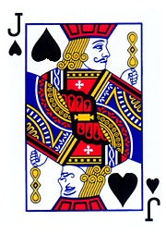
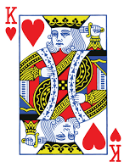
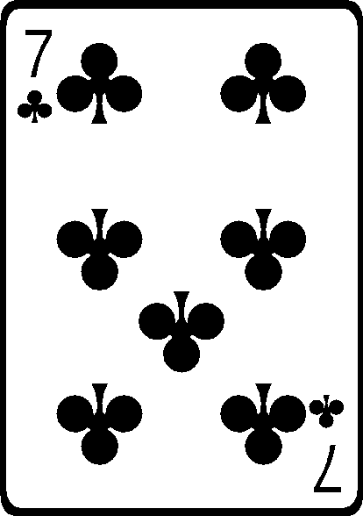
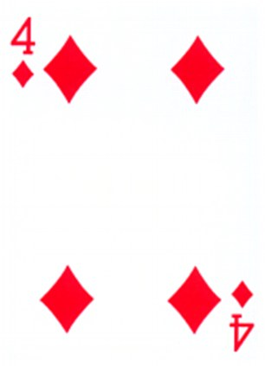
What playing card do you see?

Slide 29
Shout out the answer to the following questions
You laugh when somebody tells a ……
JOKE

Slide 30
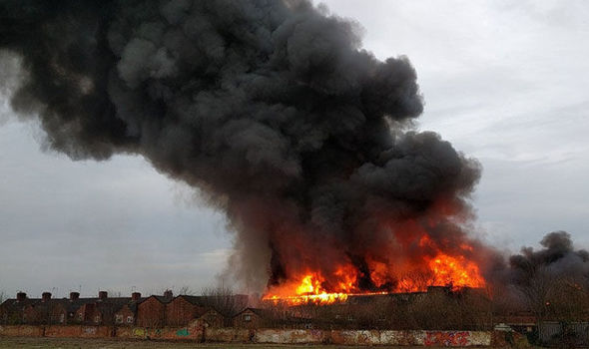
Where there is fire, there is……
SMOKE

Slide 31
I don’t like pepsi, but I do like……
COKE

Slide 32
If I have no money, I’m ……
BROKE

Slide 33
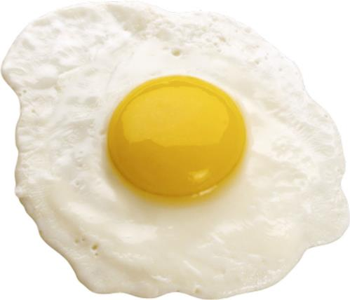
The outside of an egg is the……
YOLK

Slide 34
Nice Job…….But Wait!
The outside of an egg is the……
yolk
WHITE!

Slide 35
Quality #3: Context
Pattern Matching
Pattern recognition occurs when information from the environment is received and entered into short-term memory, causing automatic activation of a specific content of long-term memory.
An early example of this is learning the alphabet in order.
Recognizing patterns allows us to predict and expect what is coming, key for survival!
However, relying on patterns does not guarantee the future

Slide 36
Consider the following situation
Imagine the US is preparing for the outbreak of an unusual foreign disease, which is expected to kill 600 people. Two alternative programs to combat the disease have been proposed:
If Plan “A” is adopted, 200 people will be saved.
If Plan “B” is adopted, there is a 1/3 probability that 600 will be saved and a 2/3 probability that no people will be saved.
Which Plan do you adopt?

Slide 37
Consider the following situation
Imagine the US is preparing for the outbreak of an unusual foreign disease, which is expected to kill 600 people. Two alternative programs to combat the disease have been proposed:
If Plan “C” is adopted, 400 people will die.
If Plan “D” is adopted, there is a 1/3 probability that nobody will die and a 2/3 probability that 600 people will die.
Which Plan do you adopt?

Slide 38
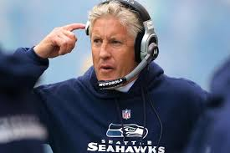
Quality #3: Context
Framing
Human approach to risk perception
Two systems for analyzing risk:
automatic/intuitive
Thoughtful/calculating
When we are considering gains, we become more conservative – hold on to the sure thing
When we expect a loss, we become more prone to take risks

Slide 39
Quality #3: Context
Framing
University of California study on NFL coaches’ 4th down decisions
Do the “Risky” thing and go for the first down, or the “Safe” thing an punt?
Teams are better off going for the first down 40% of the time
Teams actually go for the first down only 13% of the time
Would result in one additional win every 3 years

Slide 40
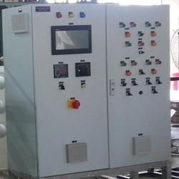
Quality #3: Context
Human-machine interface
Operations sequenced left to right, top to bottom – just as we have learned to read
Green means “go”, Yellow means “caution”, and Red means “stop” - just as we have learned with traffic lights
Flashing light means “attention please”, solid light means “satisfied”
Tags primarily use Operations language (“Fuel Gas to Heater” rather than “19-FCV-006B”)

Slide 41
Quality #3: Context
How is this a good quality? a bad quality?
What might you do to take advantage of this quality?
What Might you do to avoid the downside of this quality?

Slide 42
Quality #1: Focus and Selective Attention
Quality #2: Multi-Tasking
Quality #3: Context
Exploit the good of these qualities…
….but be aware and thoughtful of the downsides

Slide 43
Think about how you will use these on all aspects of your projects
Is someone assigned to see the “big picture” in the field?
Are human-machine interfaces designed well?
Are people taking too much, or not enough, risk?
Do your foremen have too much of a routine?
Are there high consequence activities which need a checklist and disciplined process of use to avoid multi-tasking temptations?

Slide 44
Credits/Resources
“Why We Make Mistakes”, by Joseph Hallinan
Lectures by Nelson Repenning, School of Management Distinguished Professor of System Dynamics and Organization Studies at MIT
“Thinking Fast and Slow”, by Daniel Kahneman and Amos Tversky

