Slide 1
TSO™
(Transition to Sustainable Operations)
September 21, 2016

Slide 2
Agenda
Industry - Fragmented by Nature
Fragmentation - Project Turnover Challenges
TSO™ (Transition to Sustainable Operations)
TSO™ Social Security Administration Example
The Take Away
Discussions

Slide 3
Industry – Fragmented by Nature
The Continuum of…
Design
Build / Construct
Operate
…is fragmented.

Slide 4
Industry – Fragmented by Nature
Why is the continuum fragmented?
Procurement processes drive silos
Design / Build / Cx have “exit oriented” mentality
Owner rarely includes operations in design/plan activities

Slide 5
Fragmentation – Project Turnover Challenges
Underprepared operations team
Undertrained operations staff on specialized systems
Underdeveloped SOP’s, MOP’s, EOP’s
Unorganized construction data transfer
Unplanned operations budget overruns
Unprepared for occupancy

Slide 6
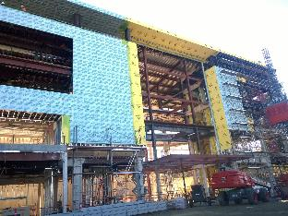
TSO™ (Transition to Sustainable Operations)
Construction
Transition
Sustainable Operations
((((Gap))))
People
Process
Technology
Construction Data

Slide 7
TSO™ (Transition to Sustainable Operations)
TSO™ was developed and trademarked by McKinstry in 2003
Recognizing the fragmentation, developed solution sets
It’s not just a construction O&M data turnover; it’s a “People, Process, Technology” framework.
People (staff, vendors/contractors, occupants)
Process (SOP’s, MOP’s, EOP’s)
Technology (BAS, CMMS, IWMS, Metrics Reporting, etc.)

Slide 8
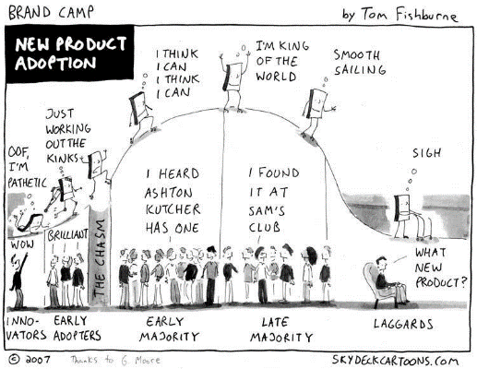
TSO™ (Transition to Sustainable Operations)
Where is TSO™ in the “new product adoption” curve?

Slide 9
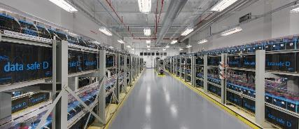
TSO™ Example
Confidential Public Facility
24x7x365
Tier 4 Data Center
250,000+ SF Building
100,000 SF of White Space
10 Megawatt Floor
1 Megawatt Solar

Slide 10
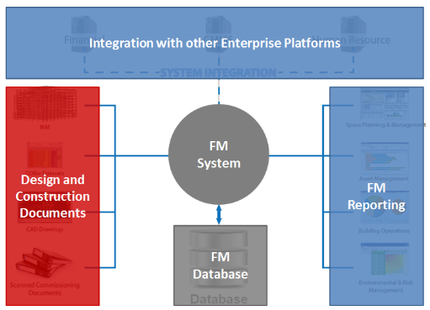
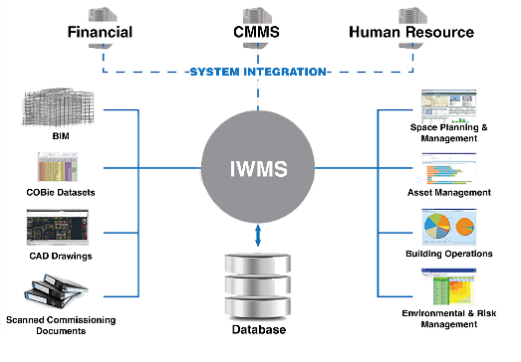
TSO™ Example
COBIE: CMMS / IWMS Comprehensive Solution

Slide 11
The Take Away!
Planning for “sustainable operations” begins at design
It’s never too early to involve operations
Think on how all things under the “People, Process, and Technology” categories are intertwined.
An adjustment (or plan) in one affects the others
Consider the data, training, and planning for all of the construction turnover handoffs
Consider how the small handoffs roll up to the bigger plan

Slide 12
Discussions
Discussions

