Slide 1
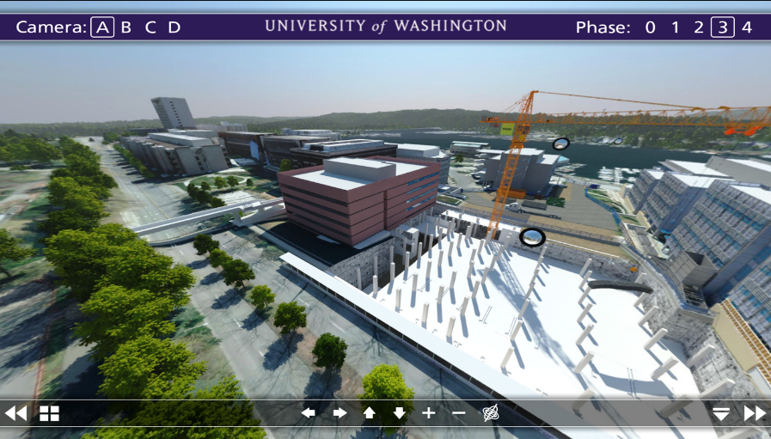
UW T2O = Transition to (Sustainable) Occupancies
prepare now for successful project transitions to occupancy
NWCCC Fall 2016

Slide 2
UW EXPERIENCE ::
Operating expenses and research budget for fiscal year 2014-15 is $6.4 billion
Over 20 million gross square footage of space
Over 520 buildings owned and 175 leased
Capital Planning & Development (CPD) has approx. $1B in projects underway at a given time
Notes:
One of the best medical schools in the world
Operating expenses and research budget for fiscal year 2014-15 is $6.4 billion
Over 20 million gross square footage of space
Over 520 buildings owned and 175 leased
Capital Planning & Development (CPD) has approx. $1B in projects underway at a given time

Slide 3
Challenges & Realities at UW…
CPD focus on capital costs vs. life cycle costs
Examples of painful failures – delivery successful, but handover & acceptance failed
Tracking issues post-completion = difficult!
Project teams able to produce powerful O+M tools – might not match FS wants or capacity
UW Finance & Facilities (F2)
Capital Planning & Development (CPD)
Facilities Services (FS)

Slide 4
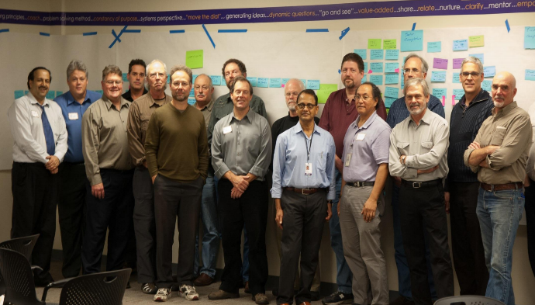
2012 UW launches an integrated LEAN team to map the ‘Current State’ and come up with ways to improve project Transitions to Occupancy (T2O)
Lean T2O Team Mission ::
+ 100% of data & docs are in place, usable, & complete by substantial completion (SCD)
+ Reduce maintenance staff & hours on non-PM tasks after SCD by 50%
+ Be 100% able to operate buildings on SCD
+ No unresolved issues (punch, CX) by Final Completion

Slide 5
T2O Ideas implemented at UW
Digital document review and collaboration
Submittal Exchange document management & collaboration
BIM-FM formatting building asset data for import UW CMMS system (COBie)
New UW O&M data specification 01 78 23 (including new UW eO&M framework)
New UW Demonstration Specification 01 79 00
New Cx specification Fire + Life Safety + Cx 01 91 00
New UW BECx specification 01 91 19 (building envelope Cx per NIBS)
Related Div. One specification coordination & integration
Project Charter – purpose document
CPO – CE/CO monthly “facetime” meetings
Issues Tracking Log - collaborative & web-based
Conduct Transition Meetings – stakeholder sessions from SC to FA
Post-Construction Conference – including learning data base & tracking solutions
Transition Best Practices - CM/PM procedure roadmap to optimize T2O
Duty to Repair – CM is first point contact through 1st year w/ service
Operations Director role to lead Training & Development for all CMs
OPS GAP :: AEC team provides occupant, operations, and performance manuals including staffing requirements & framework (pulled from Asset Matrix Info)
Notes:
BlueBeam Digital document review and collaboration - Design & Const
Submittal Exchange document management & collaboration - Design & Const
BIM-FM formatting building asset data for import UW CMMS system (COBie)
New UW O&M data specification 01 78 23 (including new UW eO&M framework)
New UW Demonstration Specification 01 79 00
New Cx specification Fire + Life Safety + Cx 01 91 00
New UW BECx specification 01 91 19 (building envelope Cx per NIBS)
Related Div. One specification coordination & integration
Project Charter – purpose document
CPO – CE/CO monthly “facetime” meetings
Issues Tracking Log - collaborative & web-based
Conduct Transition Meetings – stakeholder sessions from SC to FA
Post-Construction Conference – including learning data base & tracking solutions
Transition Best Practices - CM/PM procedure roadmap to optimize T2O
Duty to Repair – CM is first point contact through 1st year w/ service
Operations Director role to lead Training & Development for all CMs
OPS GAP :: AEC team provides occupant, operations, and performance manuals including staffing requirements & framework (pulled from Asset Matrix Info)

Slide 6
WASTE
VALUE ADDED
T2O ‘FUTURE STATE’ WHERE ::
Project teams deliver sustained occupant outcomes
Expectations about exchange and transition get prioritized at the start and championed throughout the process.
Specific comprehensive transition execution are prepared and coordinated across member workflows - Architect, Engineer, Contract, and Subcontract
Needed data is delivered in the right format for data-driven, efficient maintenance outcomes
Project teams become “Transition Service Practitioners”
New term contracts developed to fill gaps – transition service contracts, extended O+M, SOP/MOP/EOP, enhanced Cx
Notes:
Waste is minimized and value added because project teams ensure and deliver sustained occupant outcomes
Teams prepare and set expectations about the information exchange and transition to occupancy, operations and maintenance - prioritized at the get go, championed throughout the process.
Project teams prepare specific comprehensive transition execution plans that clearly identify data and deliverable requirements and coordinate them across member workflows - Architect, Engineer, Contract, and Subcontract
More efficient and data-driven maintenance outcomes are achieved - the needed data in the right format
T2O is part of what we do, its our work – project teams become “Transition Service Practitioners”
We develop new term contracts to fill gaps – transition service contracts, extended O+M, SOP/MOP/EOP, enhanced Cx – based on need

Slide 7
FUTURE STATE starts NOW
Animal Research & Care Facility
Life Sciences Building
New Burke Museum
NanoEngineering and Sciences Building
Computer Sciences & Engineering Expansion
UWMC New Entry Project
North Campus Student Housing
West Campus Utility Plant
Bothell UW4 STEM & Residence Halls

